Slide 1
Pet Feed
Group 8

Slide 2
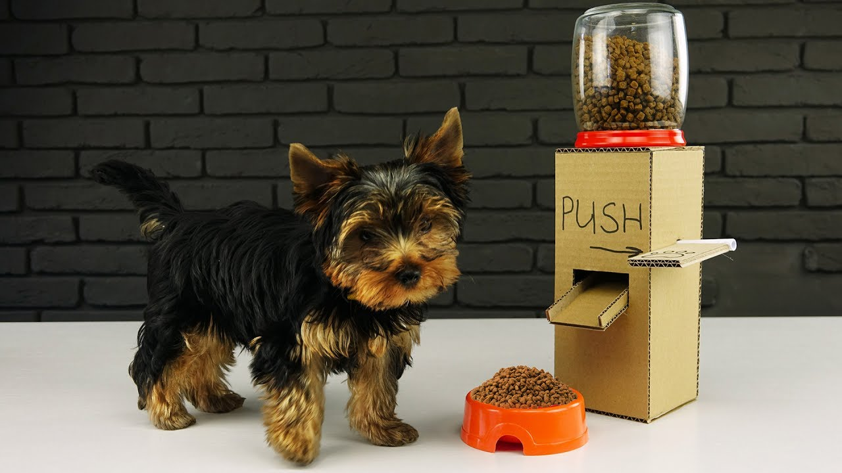
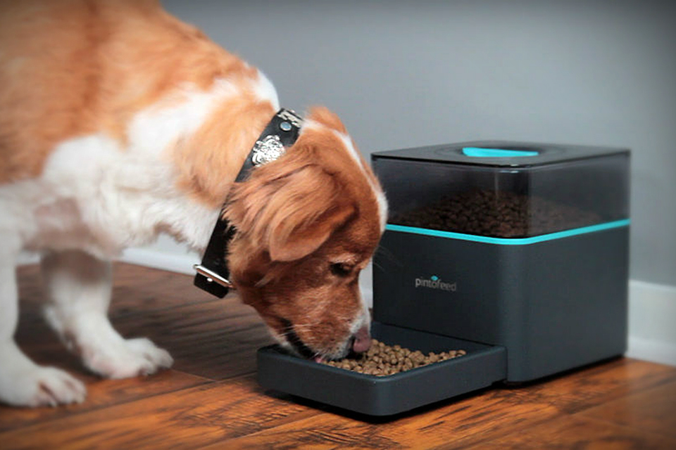
Project Description
Utilizes Android application to set time and amount for future pet food dispense.
Simulate smart pet feeder in the market.
Useful for people who are busy or blind.
Greatly increase the happiness of our friend, the lovely pet.

Slide 3
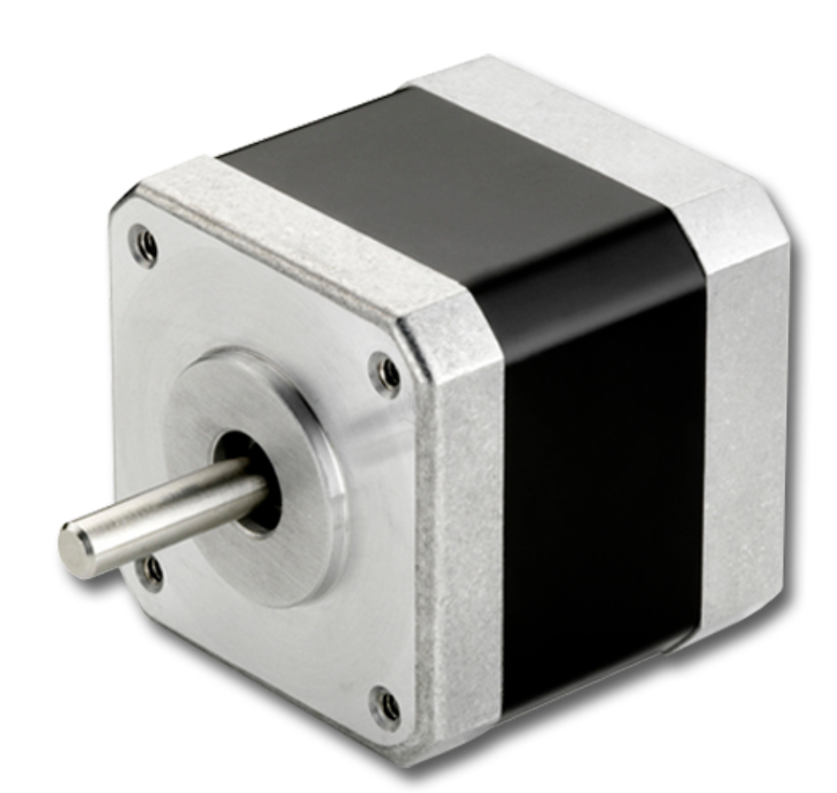
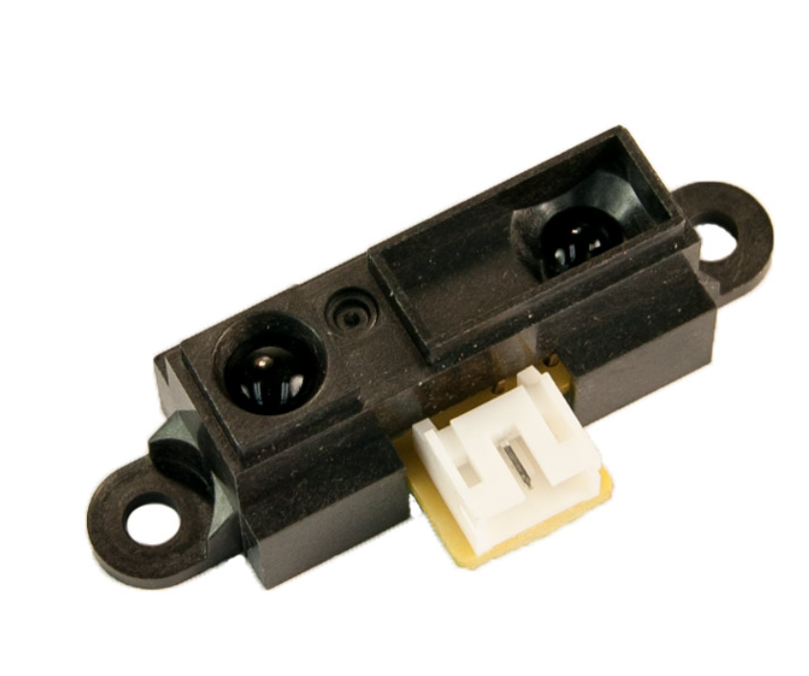
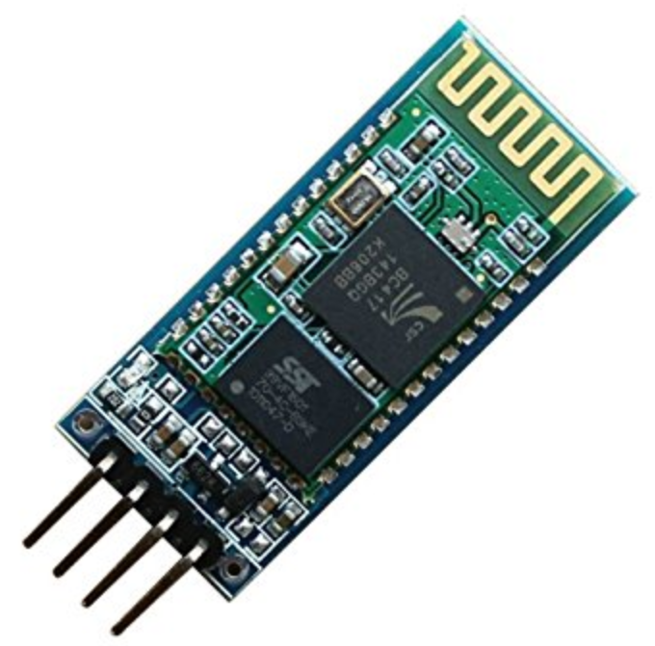
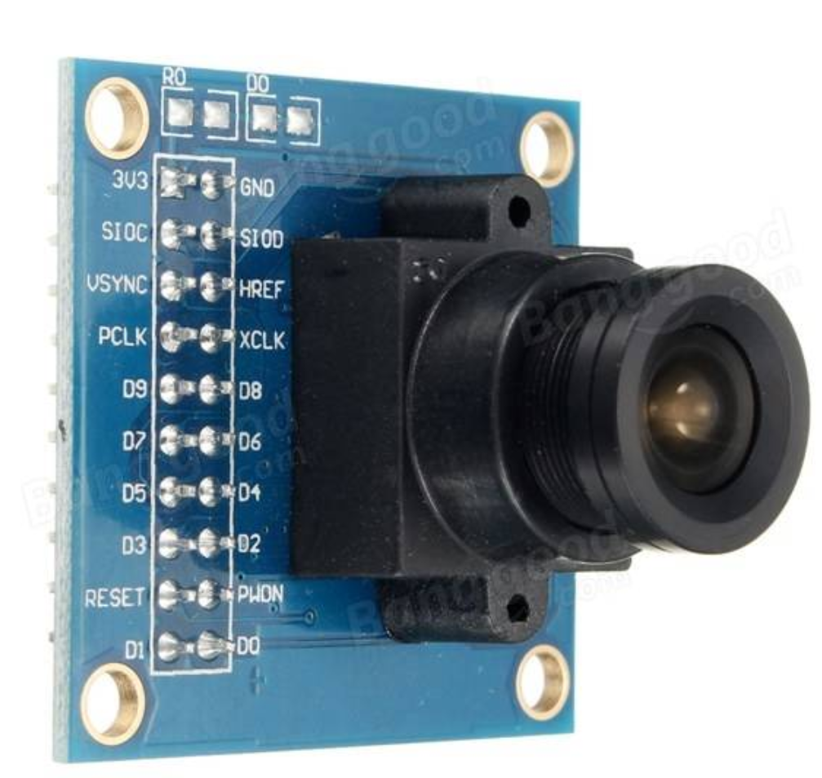
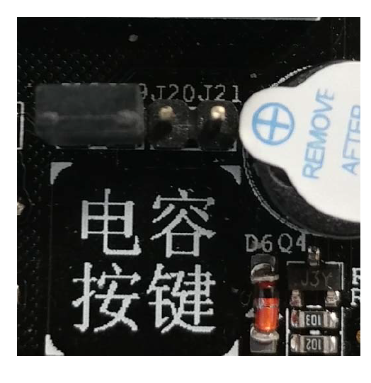
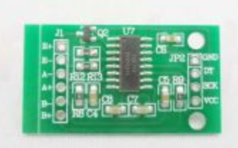
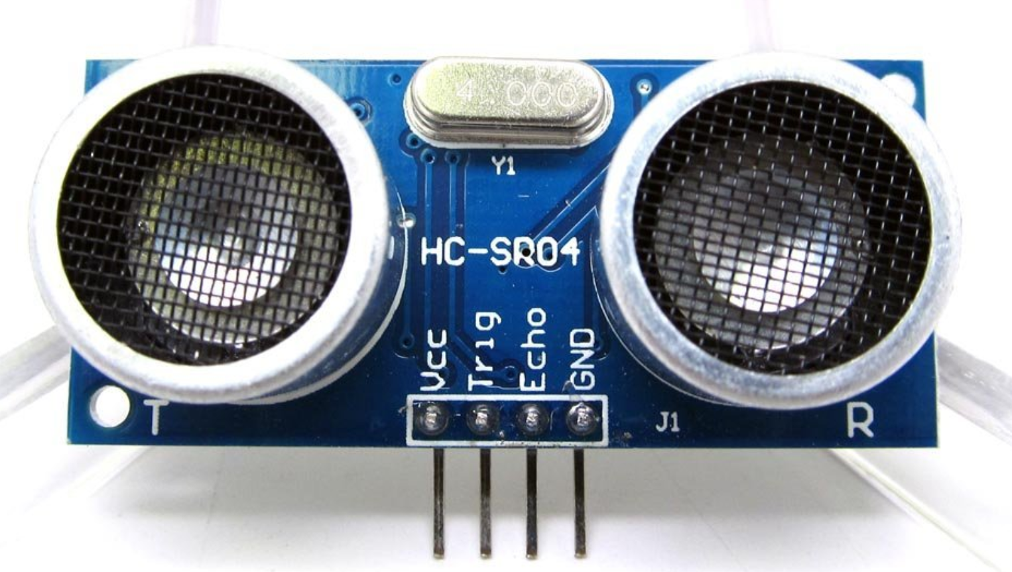
User sets time for dispense and also chooses amount
(Bluetooth)HC-04
GP2Y0A41SK0F IR Sensor
Pet food dispensed
Stepper Motor
OV7725 (Camera)
Buzzer goes on to alert the pet
HX 711 (Digital Weight)
Buzzer
Camera takes photo and saves to SD card
If not fully consumed, alert goes off again
HC SR04 (Ultrasonic)

Slide 4
Software Design
Polling / Interrupt (from Lab 2) Infrared Proximity Sensor Buzzer Ultrasonic Sensor Camera | DAC Conversion (from Lab 5) Digital Weight Infrared Proximity Sensor Ultrasonic Sensor
Timer / Buzzer (from Lab 4) Different frequency - > Different sound Buzzer | I2C (from Lab 6) Digital values -> Different functions

Slide 5

Limitation & Improvement
Difficulties in bluetooth communication between Android phone and STM32.
Implementing correct calculation for dispensing the pet food at pre-registered time.
Calibrating the rotation of the motor to dispense food according to the given input.
Future Improvement: playing .wav file from SD card

